Slide 1


Cricket team selection
Name :- Shakti Parmar
branch :-CE
Roll no :-213
Enroll no. :-22002170110101

Slide 2


INTRODUCTION
This System Is Comuterized Method of Player Selection.
In This System We Select And Bidds Player.
We Creat Our Team.

Slide 3

Functionality
We see player all details.
We bidd for player.
We can bidd and buy good player.

Slide 4

Merits and demerits
Merits
Demerits
Easy to use.
We cheak player data and
bidd .
Save time .
It is not efficient..
Depends on technology.

Slide 5

FUTURESCOPE
Player traking
Injury Prediction
Predictive modeling

Slide 6
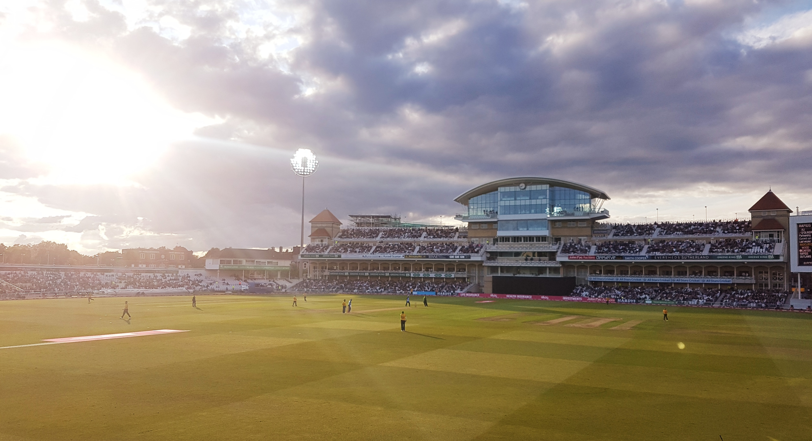
Thank you…

